Slide 1
Department of Labor Proposal
Sophia Lugo, Neil Bajaj, Man Jiang, Arjun Malleswaran

Slide 2
What programs can be implemented in the regions with the most struggling industries that could help them get back to pre-covid statistics?
Notes:
By determining the overlap of the most struggling industries with the most impacted regions, the US department of labor can:
Provide a wider array of job opportunities across the US
Adjust wage and hour standards in regions that suffered the most.

Slide 3


Background
“To foster, promote, and develop the welfare of the wage earners, job seekers, and retirees of the United States”
Creating more job opportunities helps the economy by GDP
The goal is to restore a healthy job growth: more job listings indicate more job opportunities, in turn reduce the unemployment rate and increase tangible productivity benefits.
Notes:
We will answer the question by looking at how the job postings change over time and in different regions. economic growth tends to be positively associated with job creation and that’s what the department of labor cares about because the mission is to “”. Creating jobs helps the economy by GDP. When an individual is employed, they are paid by their employer. This results in them having money to spend on food, clothing, entertainment, and in a variety of other areas. The more an individual spends, the more that demand increases. When demand for a product or service increases, companies increase their output to meet the increased demand. Companies do this by investing more and hiring more workers. More workers start the cycle over, with there being even more money spent in the economy, increasing demand further. Therefore, the goal here is to restore a healthy job growth by encouraging more job listings, which indicate more opportunities and thus reduce the unemployment rate and increase the tangible productivity benefits

Slide 4
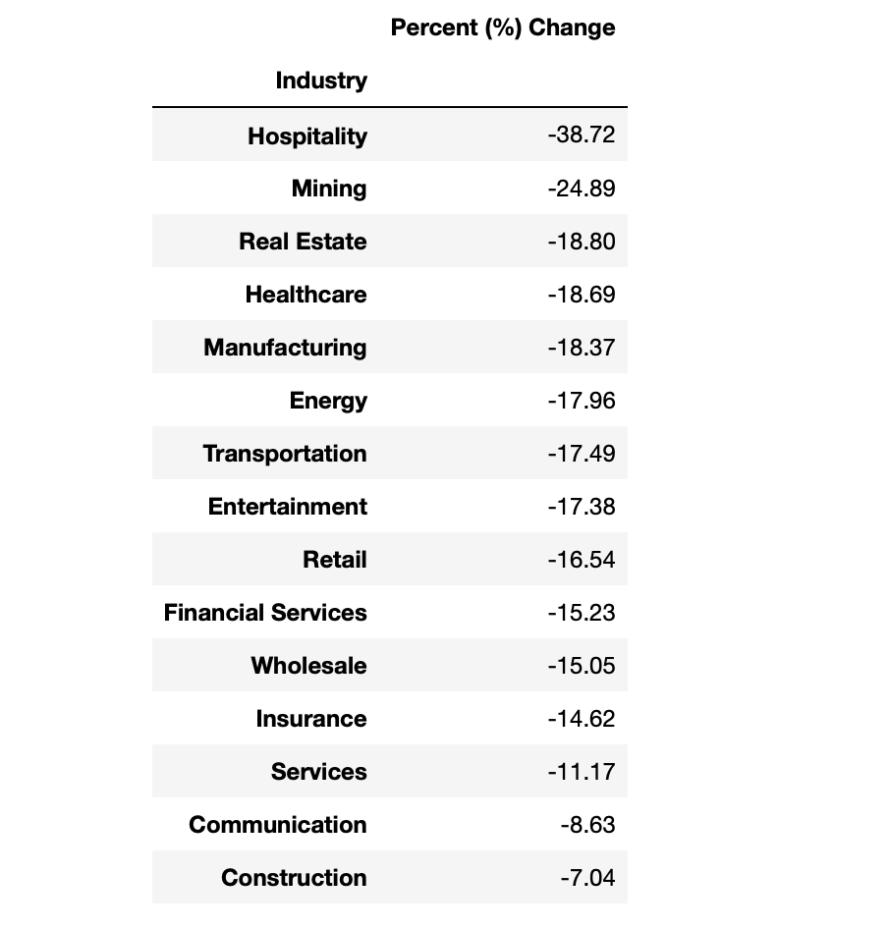
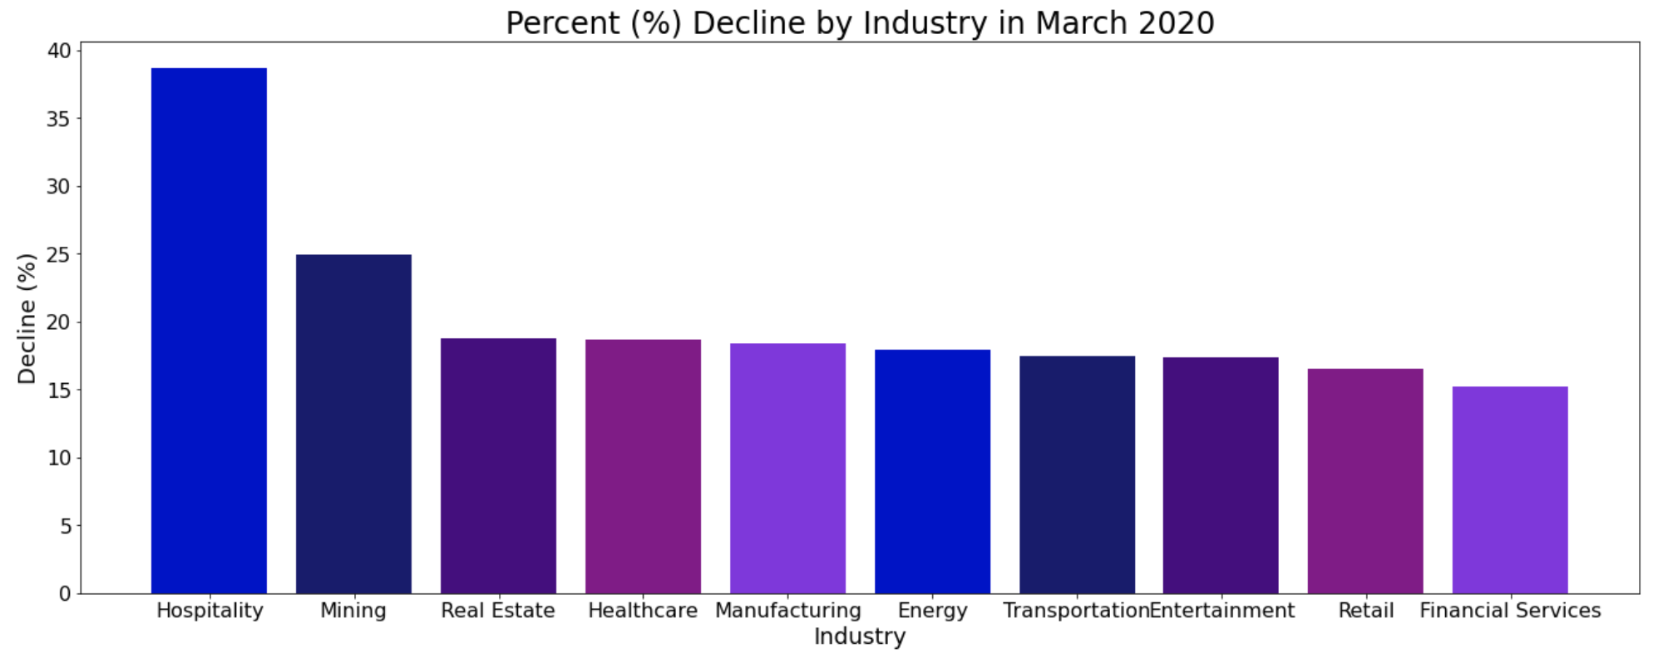
Finding the most impacted industries
Change over 1 month
Percent Change:
the average change in the number of job listings per week in the time period compared to the listings in the week of Feb 24 - March 1, 2020
Decline in all industries.
Notes:
Tables in ascending order, meaning the most hit industries are at the top and the least hit are at the bottom.
Neil
Explain percentage change
Explain the data frame and graph
Graph of top 10 industries
(-) showing decline in number of job listings per industry showing how badly each industry suffered
Explain trends in between 1-3-6 months

Slide 5
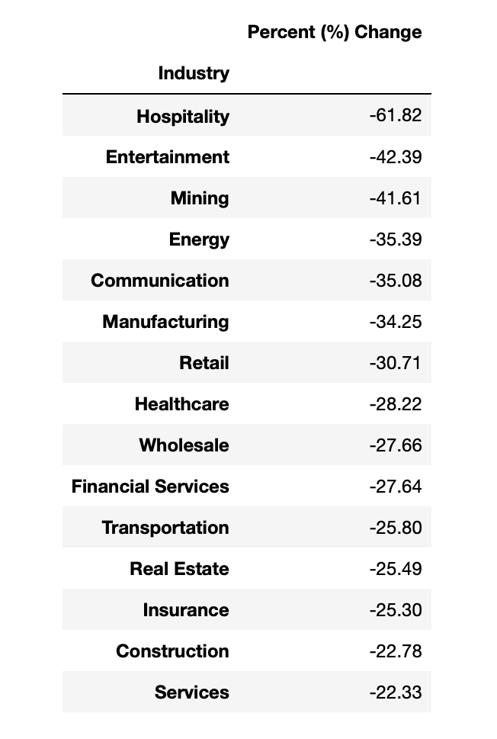
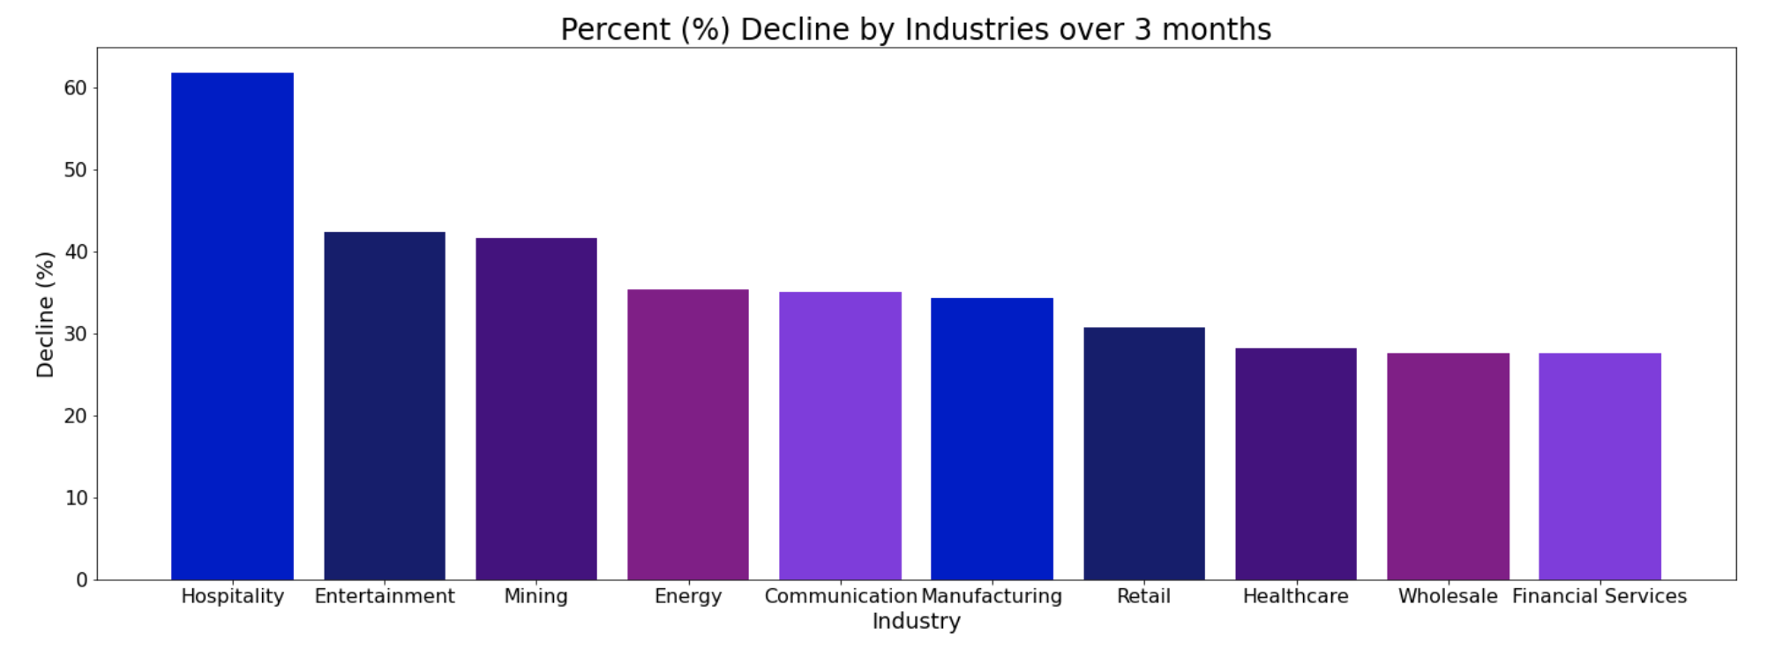
Finding the most impacted industries
Change over 3 months
Percent Change:
the average change in the number of job listings per week in the time period compared to the listings in the week of Feb 24 - March 1, 2020
All industries were hit even harder, but hospitality remains the worst.
Notes:
Tables in ascending order, meaning the most hit industries are at the top and the least hit are at the bottom.
Neil
Explain the data frame and graph
Graph of top 10 industries
(-) showing decline in number of job listings per industry showing how badly each industry suffered
Explain trends in between 1-3-6 months

Slide 6
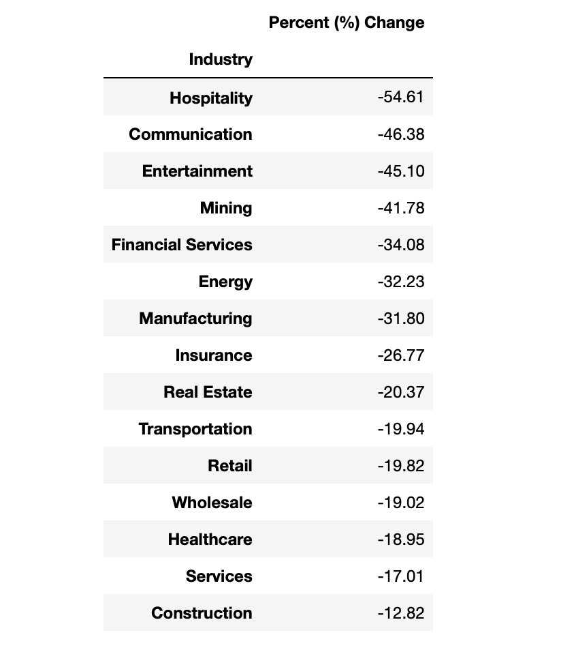
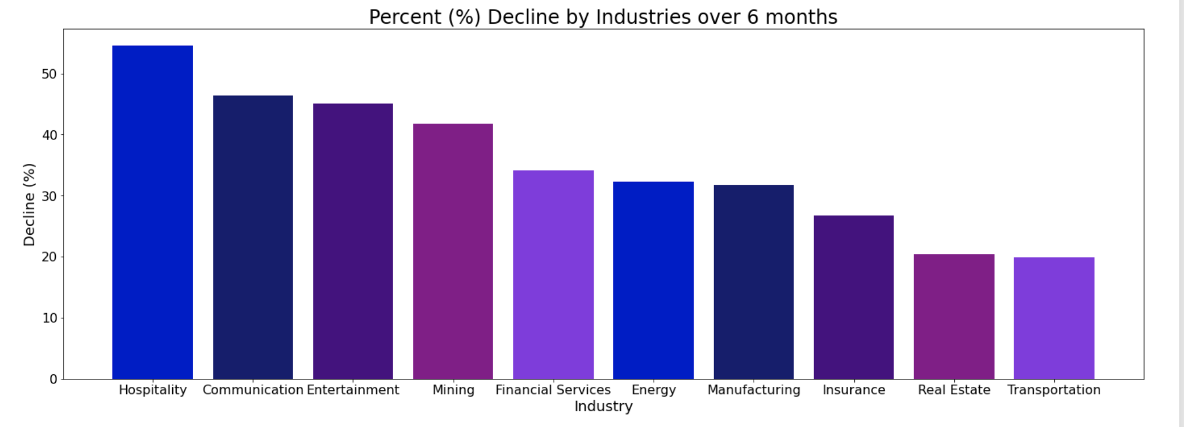
Finding the most impacted industries
Change over 6 month
Percent Change:
the average change in the number of job listings per week in the time period compared to the listings in the week of Feb 24 - March 1, 2020
First time fluctuation is seen.
Notes:
Tables in ascending order, meaning the most hit industries are at the top and the least hit are at the bottom.
Neil
Explain the data frame and graph
Graph of top 10 industries
(-) showing decline in number of job listings per industry showing how badly each industry suffered
Explain trends in between 1-3-6 months

Slide 7
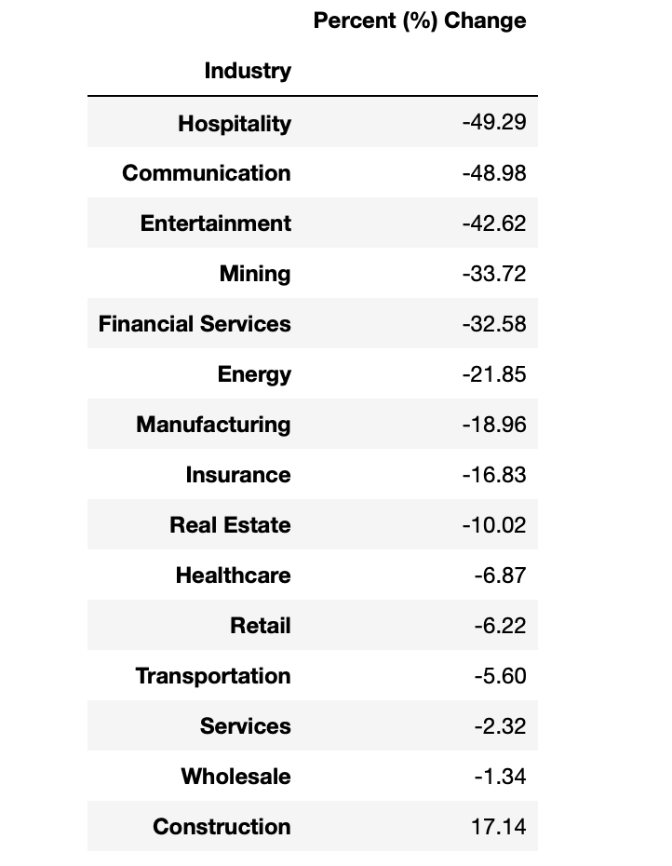
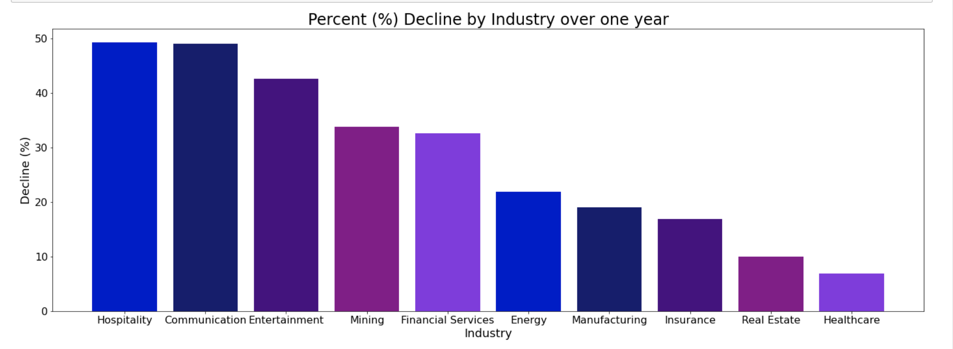
Finding the most impacted industries
Change over 12 months
Percent Change:
the average change in the number of job listings per week in the time period compared to the listings in the week of Feb 24 - March 1, 2020
Growth in most industries with the first time a positive number is seen.
Notes:
Tables in ascending order, meaning the most hit industries are at the top and the least hit are at the bottom.
Sophia

Slide 8
Industries we’ll focus on
Hospitality - most impacted through all our data
Healthcare - significant to COVID-19
Entertainment - top 3 impacted in more recent data
Real Estate - equally impacted over every time frame
Communication - initially minimally impacted but becomes a top hit industry
Notes:
sophia

Slide 9
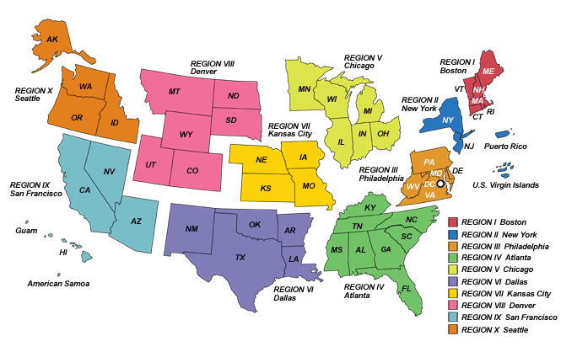
Splitting the US into regions
Taken from the US Department of Labor
Notes:
Talk about how this was already created by the US Department of Labor and how we used it in our project
Why did we do this instead of using the states?
Each section has their own regional office so it’d be easy to implement programs with states that share offices

Slide 10
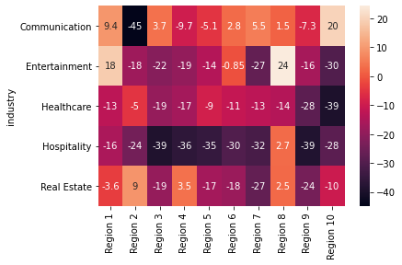
How were these regions affected?
Change over 1 month: to March 2020
Communication: NY, NJ, PR
Entertainment: regions along the coasts; northeastern and middle part were less impacted.
Healthcare: across the country, with the west coast (Region 9 & 10) hit the most.
Hospitality: across the country
Real estate: no obvious geographical pattern
Notes:
We created heat maps to visualize how the five industries different in percentage change of job postings over 1 month and over 1 year. Here it shows the change over a month, which is the beginning to the end of March in 2020. Each grid represents one industry in a specific region and the darker th color, the more the industry in that region is impacted. So here we see that the communication industry was hit the hardest majorly in Region 2, which is consisted of New York, New Jersey, and Puerto Rico. This might not be that surprising because New York is called the communication arts capital of the world so it sharly cut down the number of job postings as the pandemic started.
The entertainment industry was hit the hardest by the coasts, and areas such as northeastern region such as Maine and middle part such as Wyoming were less impacted and this could be partially explained by that lower population density in these areas so that less involvement of entertainment industry and thus less impacted.
The healthcare industry was hit across the country, with the west coast (Region 9 & 10) hit the most as the pandemic started its wave from the west coast
Similarly, the hospitality industry was also hit across the country, and it was hit the hardest among these 5 industries on average, and most of the regions have experienced a rapid cut down of job listings just in the month
For the real estate industry, there was no obvious geographical pattern how it was impacted though it was majorly in the west coast and some states in the middle.

Slide 11
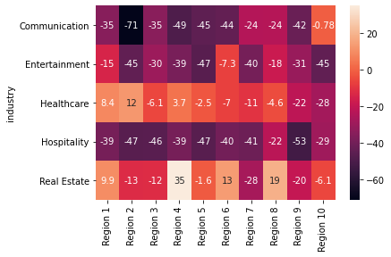
How were there regions affected?
Change over 1 year: to Feb 2021
Communication: across the country, with Region 2 getting worse
Entertainment: across the country
Healthcare: most are recovering, with little progress for the west coast
Hospitality: getting worse across the country
Real estate: densely populated regions are still struggling
Notes:
This heatmap shows how the percent changes of the number of job postings in a year
The communication industry has experienced a much worse cut down of job listings in the year and in most of the regions compared to the start of pandemic. Also for the entertainment industry it was impacted across the country instead of only the coasts

Slide 12
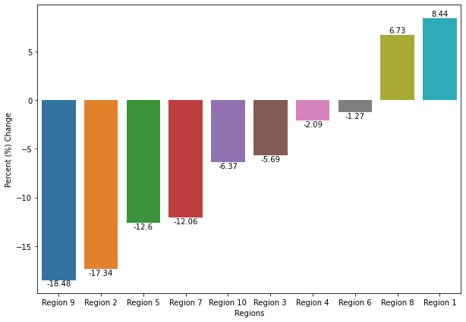
Which regions were impacted the most?
From Mar 2020 to Sept 2021
Notes:
Region 9 and region 2
are the most densely populated regions and hence were impacted the most.

Slide 13
Programs to Implement
Additional Programs
Give incentives to companies in industries where more listings are needed
Real Estate: Relocation and expansion incentives to people and small businesses respectively
Policy Change
Reduce the policy restrictions on businesses within struggling industries

Slide 14
Thank You!

